Slide 1
Distributed Control and Automation Framework (DCAF)
Static Modules
Instructor Name
Instructor’s role
Notes:
People that contributed with this content:
Benjamin Celis
Mathew Pollock
Simon Perez
Andres Gomez

Slide 2
Agenda
Initial Considerations
Creating Static Modules
Modifying the UI and Defining Parameters
Modifying the Initialization
Implementing the Input, Output, and/or Processing Methods
Supported Targets and Other Editor Options
Updating Channels and Scripting Tool
Quiz

Slide 3
Initial Considerations

Slide 4
Considerations
Input, Process or Output.
Static or Dynamic
Configuration Parameters

Slide 5
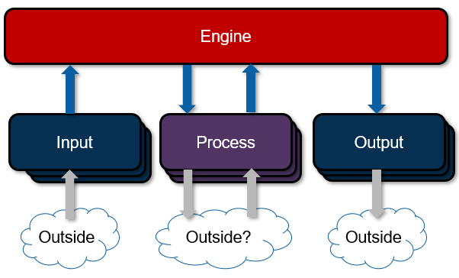
Considerations – Input, Process or Output
Input:
Input Data into the Engine.
Output:
Output Data from the Engine
Process:
Receives Processing Parameters from the Engine.
Generates Processing Results for the Engine.

Slide 6
Considerations – Static or Dynamic
Static
Module developer defines the number of channels available in the module
Template includes UI ready to use.
Easier to Create
Commonly used for processing
Dynamic
Final user can configure the number of channels.
More flexible template
Requires more codding.
Commonly used for input/output
Notes:
In this lesson we will study with detail static modules

Slide 7
Considerations – Configuration Parameters
Parameters used to configure my module.
Configurable by the user from DCAF editor.
Can’t change in runtime
Notes:
What information needs to be configurable?
The Scan Engine module needs to be able to configure the channels needed as well as the Scan Period
A control algorithm might configure the control gains required for a particular application.

Slide 8
Creating Static Modules

Slide 9
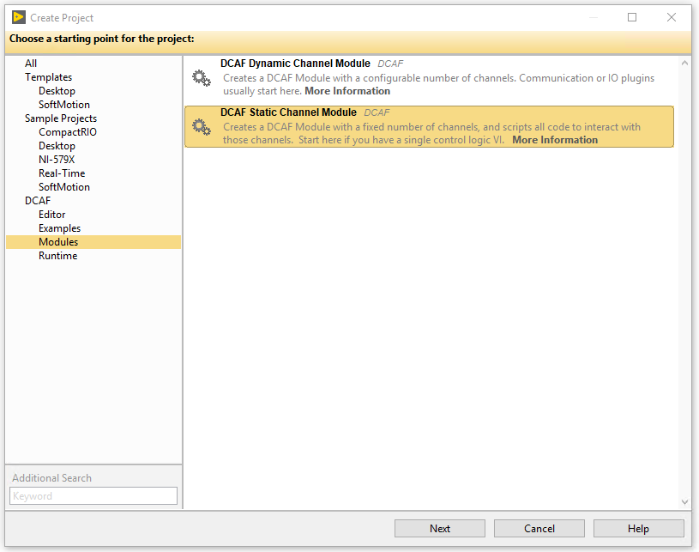
Use DCAF Static Channel Module Template

Slide 10
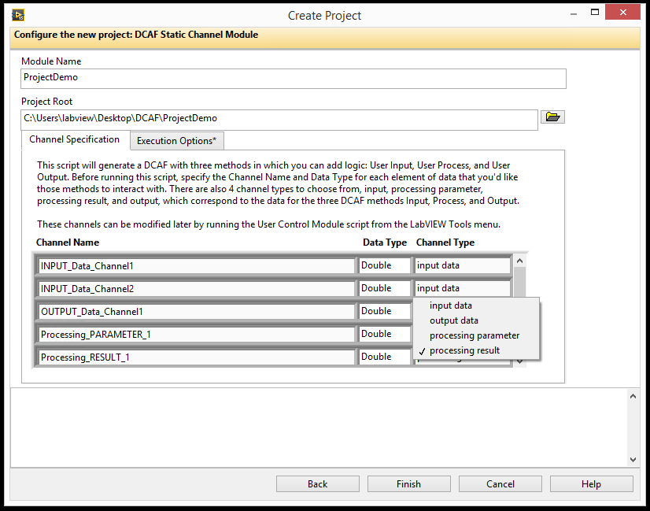
Defining the Channels
Engine
Input
Process
Output
Input
Process
Output
Input
Process
Output
Outside
Outside?
Outside
Notes:
In the Create Project page, give your module a descriptive and unique name and choose a place to store it on disk. Next, add each of the static channels by name and carefully choose the correct channel type (Input data, Output Data, Processing parameter, and Processing result). It is important to pick the correct channels in this stage to avoid having to rescript the module (explained later).
On the Execution Options tab, specify the number of execution instances allowed for the module. This field can be used to prevent multiple copies of a module from being added to a configuration in cases where this may cause unwanted behavior (for example if they must share a resource like the LED module). In most cases this value should remain set to –1 for unbounded numbers of modules, in some cases 1 is appropriate, and very occasionally a different integer should be used.

Slide 11
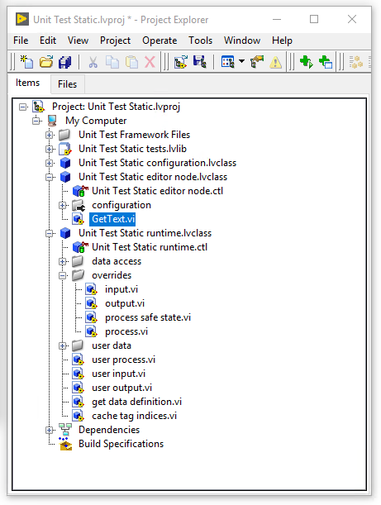
Static Module
Configuration Class:
Select module options (number of instances, allowable targets)
Update validate.vi with validation rules
Update get default error list.vi with default error classifications
Editor Class:
Select module glyph
Runtime
Implement User Input.vi, User Process.vi, and/or User Output.vi with custom logic
Notes:
Highlight that we will mainly focus in building our functionality in the runtime class. Most of the job is already done in the editor and configuration. We just may need to modify a few VIs to further customize our module in these last 2 classes.

Slide 12
Modifying the UI and Defining Parameters

Slide 13
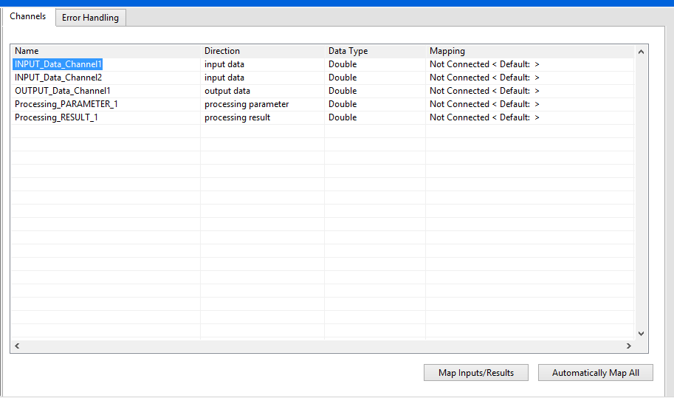
Module UI - DCAF Editor
Notes:
Having created the module, the UI portion should already be ready to run. Add the module to the Configuration Editor's search path and try adding it to a configuration. The built-in UI will populate a tab for Channels and one for Error handling. If no channels have been defined at creation (a rare but legitimate use-case), the tab itself will not appear. Note that there is no Parameters section in the UI by default

Slide 14
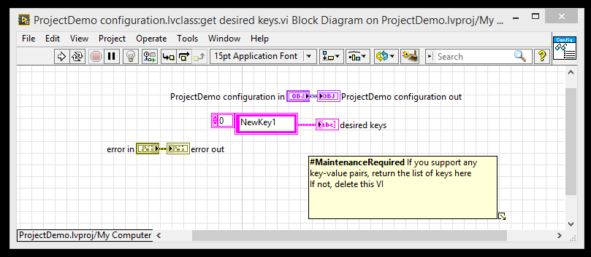
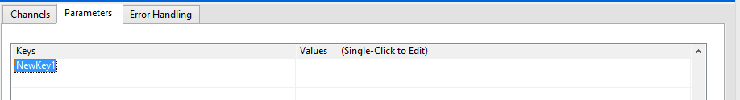
Adding Parameters
Modify get desired keys.vi in the Configuration Class
Added keys will show up as parameters in the UI

Slide 15
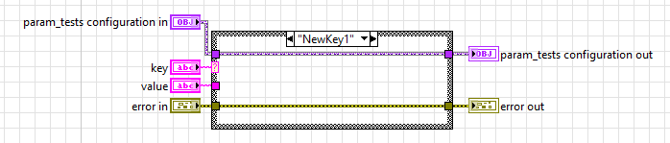
Adding Parameters
Modify validate key value pair.vi to validate user’s input for each parameter
Notes:
Having added the parameter to the get desired keys.vi, next modify the validate key value pair.vi. This VI pulls out the parameter and can be used to check whether the value for the parameter is valid. By default, any new parameter takes this VI to the default case that calls the parent method which throws an error. If there is any error in this VI the value will be erased.
For the case of NewKey1, we could assume any string value to be correct

Slide 16
Exercise
Hands On 2 Exercise 1 Part A
Notes:
https://github.com/LabVIEW-DCAF/Documentation/blob/master/Trunk/Getting%20Started%20Material/Hands%20On/Hands-On_2/DCAF_Hands_On_2.md
Students will follow the instructions to finish Hands On 2: Part A: Create a Static PID Module
Estimated Time: 20 minutes.

Slide 17
Exercise 1: Custom PID
Create module from template
Add parameters:
Output Range High
Output Range Low.
Implement the user process
Channel | Data Type | Channel Type
Variable | Double | Process Parameter
Setpoint | Double | Process Parameter
Output | Double | Result

Slide 18
Modifying the Initialization

Slide 19
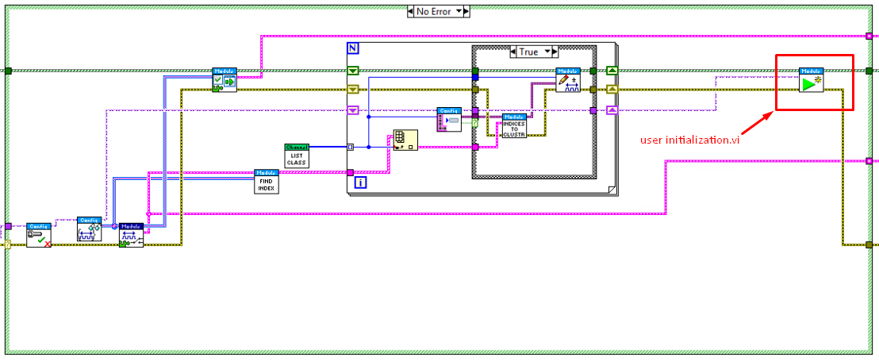
Runtime Module Initialization
Most of the Initialization will be done by the parent init.vi method
We can override the user initialization.vi with our custom initialization code.
Notes:
The image shows the parent init.vi that we typically won’t modify. In the rectangle, we show the user initialization that we will override with custom functionality.

Slide 20
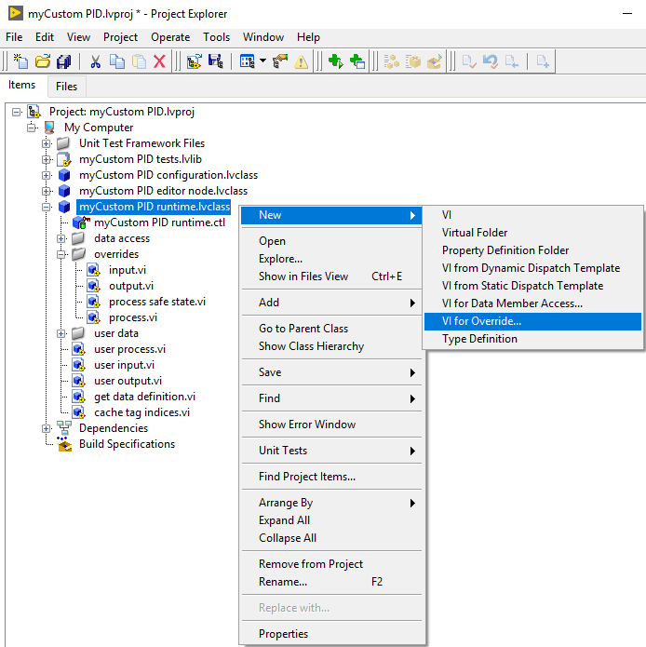
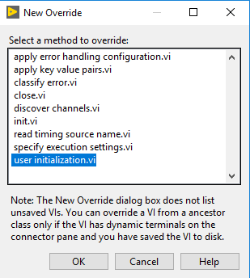
Runtime Module Initialization
To override user initialization.vi:

Slide 21
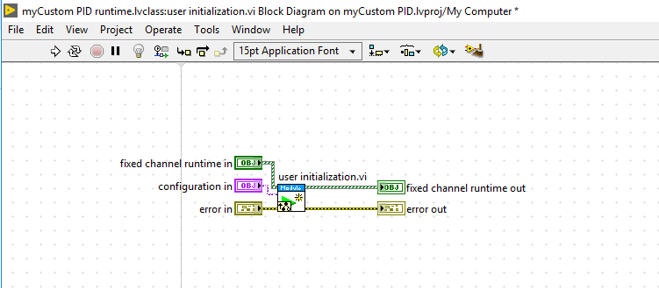
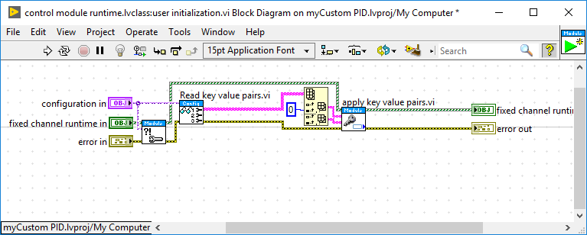
Runtime Module Initialization
To override user initialization.vi:
Notes:
Keep the call to the user initialization parent. Add your custom functionality next to it.
Second image shows what is inside the parent user initialization. We typically want to override the apply key value pairs to store our parameters into our runtime class

Slide 22
Implementing the Input, Output, and/or Processing Methods

Slide 23
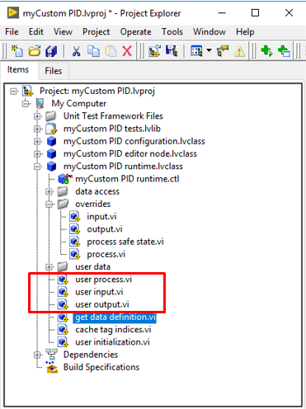
Runtime Class Input, Output and Process
VIs in overrides folder are typically not modified
Modify user VIs with custom functionality.

Slide 24
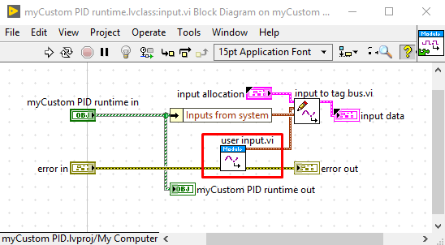
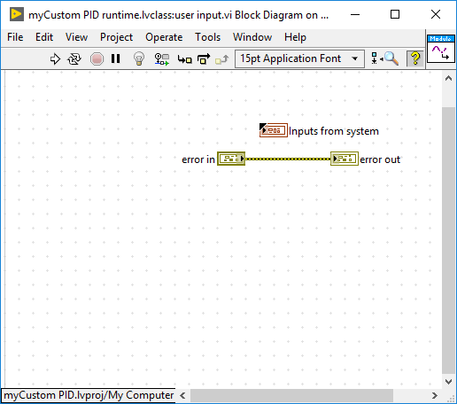
Input and User Input VIs

Slide 25
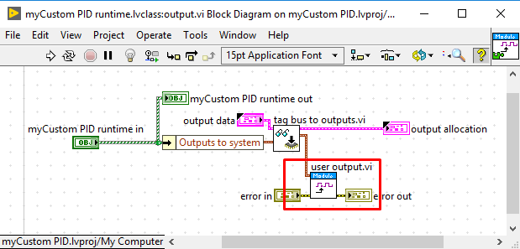
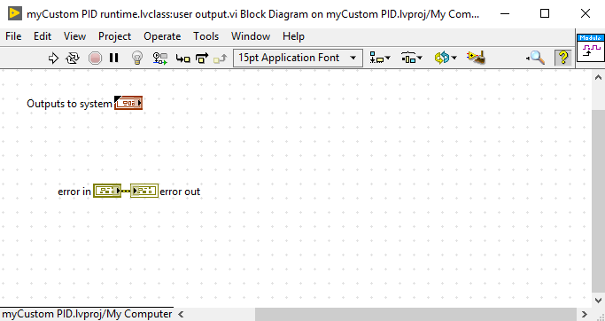
Output and User Output VIs

Slide 26
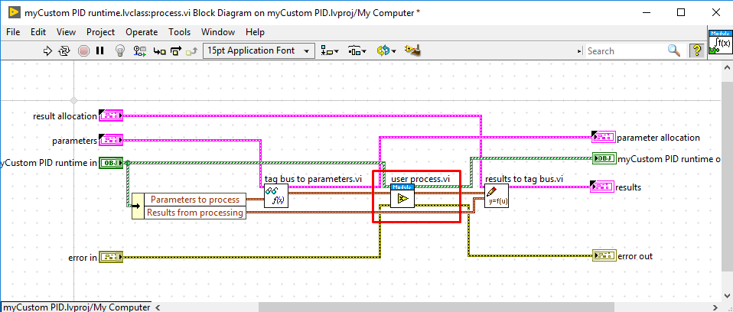
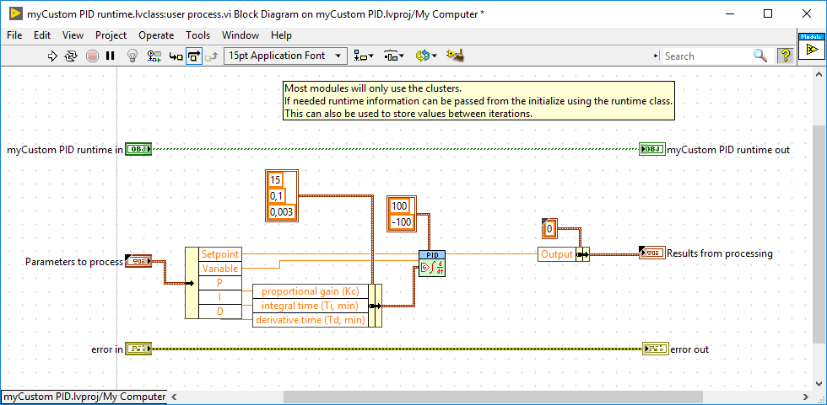
Process and User Process VIs

Slide 27
Performance Considerations for Code in Modules
Operate deterministically.
Be non-blocking.
If conditions above are not met, consider having the module running asynchronously.

Slide 28
Exercise
Hands On 2 Exercise 1 Part B
Notes:
https://github.com/LabVIEW-DCAF/Documentation/blob/master/Trunk/Getting%20Started%20Material/Hands%20On/Hands-On_2/DCAF_Hands_On_2.md
Students will follow the instructions to finish Hands On 2: Part B: Modify the Initialize and Implement the User Process
Estimated Time: 25 minutes.

Slide 29
Supported Targets and Other Editor Options

Slide 30
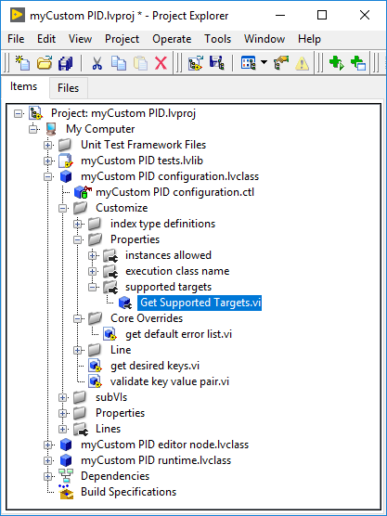
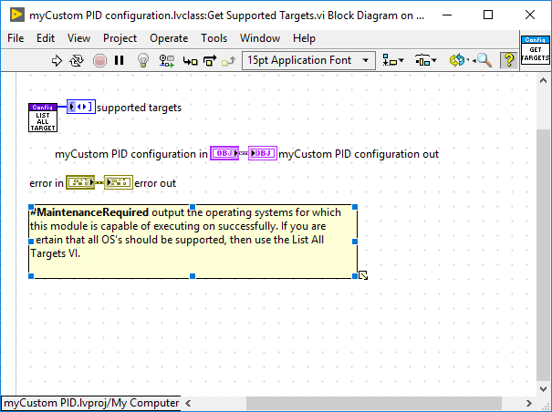
Modify Supported Targets

Slide 31
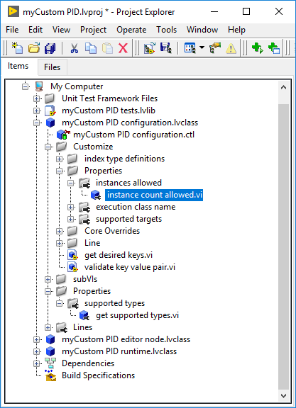
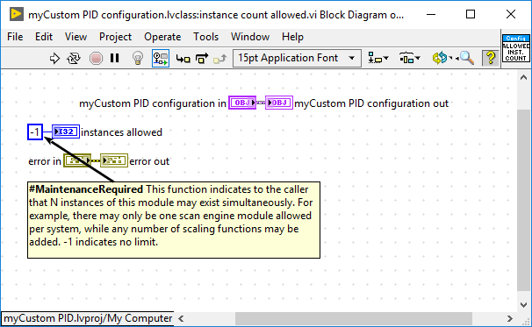
Modify Instances Allowed

Slide 32
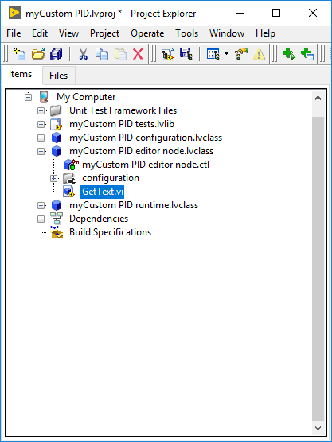
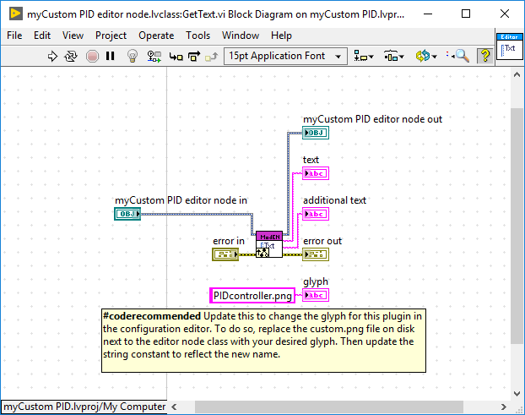
Modify Module Glyph in Editor

Slide 33
Updating Channels and Scripting Tool

Slide 34
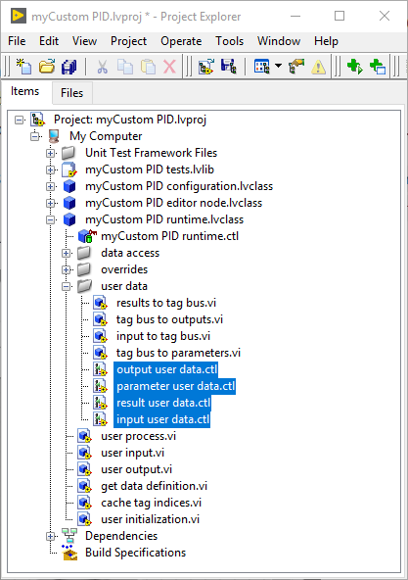
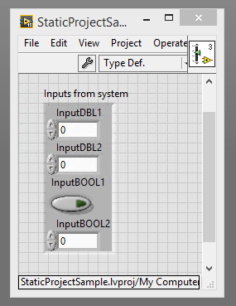
What if I need to change the Channels of my Module?
Modify the corresponding user data control

Slide 35
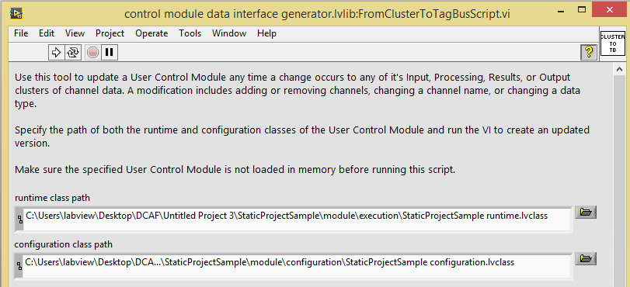
What if I need to change the Channels of my Module?
Use the Module Scripting Utility to regenerate the data accessors for your module
Tools >> DCAF >> Launch Control Module Scripting Utility

Slide 36
Exercise
Hands On 2 Exercise 1 Parts C and D
Notes:
https://github.com/LabVIEW-DCAF/Documentation/blob/master/Trunk/Getting%20Started%20Material/Hands%20On/Hands-On_2/DCAF_Hands_On_2.md
Students will follow the instructions to finish Hands On 2:
Part C: Update the Static PID Module with Scripting
Part D: Running and Configuring the Module
Estimated Time: 22 minutes.

Slide 37
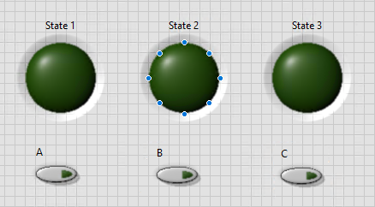
Project 2: State Machine
The starting State is defined in a Parameter
To change from 1 to 2. Only A is True
To change from 2 to 3. Only B is True
To change from 3 to 1. Only C is True
State 1
State 2
State 3

Slide 38
Exercise
Hands On 2 Exercise 2
Notes:
https://github.com/LabVIEW-DCAF/Documentation/blob/master/Trunk/Getting%20Started%20Material/Hands%20On/Hands-On_2/DCAF_Hands_On_2.md
Students will follow the instructions to finish Hands On 2:
Part A: Create the state machine module
Part B: Create a DCAF Application that runs the Static Module
Estimated Time: 40 minutes.
Students don’t have detailed instructions. Instructor will be active to help students individually as they make progress to avoid they get lost.

Slide 39
Quiz

Slide 40
Select the properties for a static module
Developer defines fixed inputs and outputs for the module.
Developer has to code most of the functionality for the UI that shows up in the editor.
Most commonly used for processing.
Can only have one instance of the module per system.
Notes:
A and C

Slide 41
Select the properties for a static module
Developer defines fixed inputs and outputs for the module.
Developer has to code most of the functionality for the UI that shows up in the editor.
Most commonly used for processing.
Can only have one instance of the module per system.
Notes:
A and C

Slide 42
I need to implement a module that will read 3 tag values from an external instrument. What type of module should I use?
A dynamic input module.
A static output module
A static input module
A dynamic output module.
Notes:
C

Slide 43
I need to implement a module that will read 3 tag values from an external instrument. What type of module should I use?
A dynamic input module.
A static output module
A static input module
A dynamic output module.
Notes:
C

Slide 44
For the previous module, I will need to open a Visa session to communicate through RS232 with my instrument. What VI in the runtime class should I override to open this communication?
init.vi
user process.vi
user input.vi
user initialization.vi
Notes:
D

Slide 45
For the previous module, I will need to open a Visa session to communicate through RS323 with my instrument. What VI in the runtime class should I override to open this communication?
init.vi
user process.vi
user input.vi
user initialization.vi
Notes:
D

Slide 46
Resources

Slide 47
Resources
DCAF Developer Guide:
Chapter 4: Creating New DCAF Modules
Notes:
https://github.com/LabVIEW-DCAF/Documentation/blob/master/Trunk/Getting%20Started%20Material/devguide/ch4_Creating%20Modules.md#4-creating-new-dcaf-modules

